Slide 1
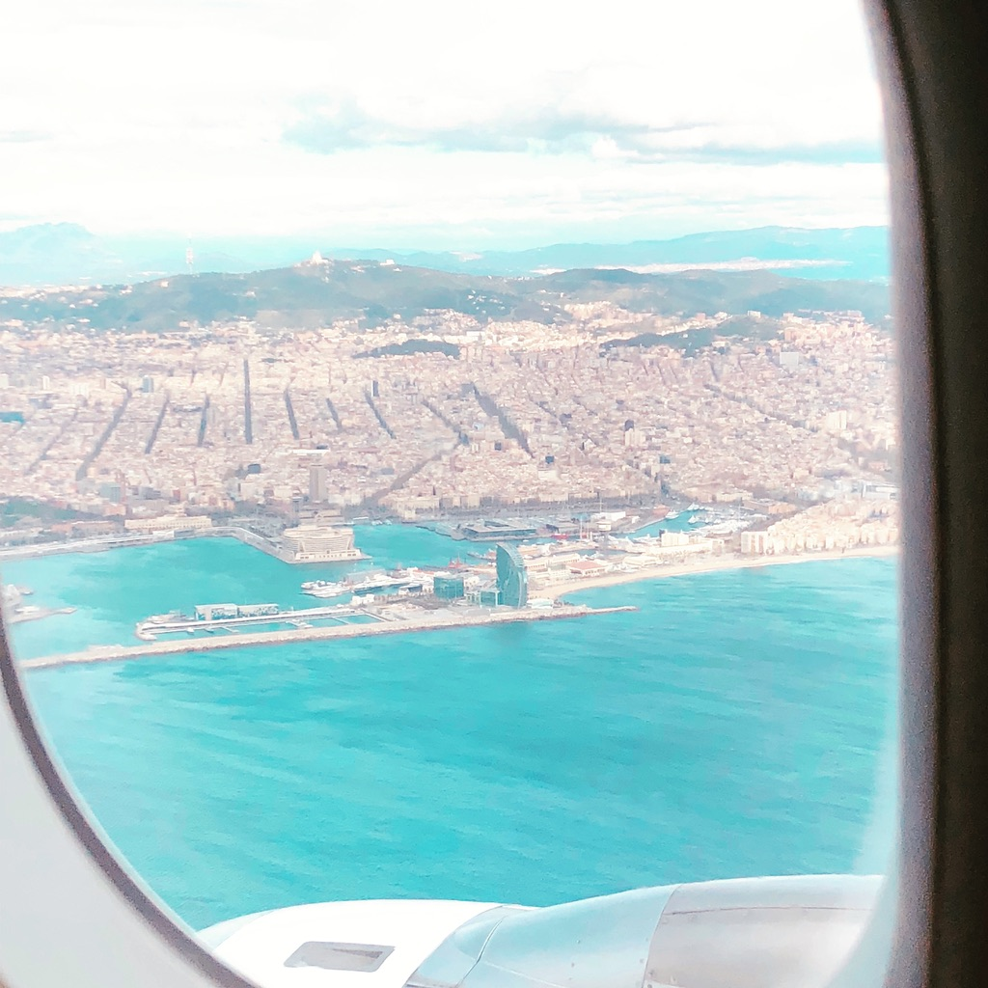
Barcelona
Notes:
Arriving…:)

Slide 2
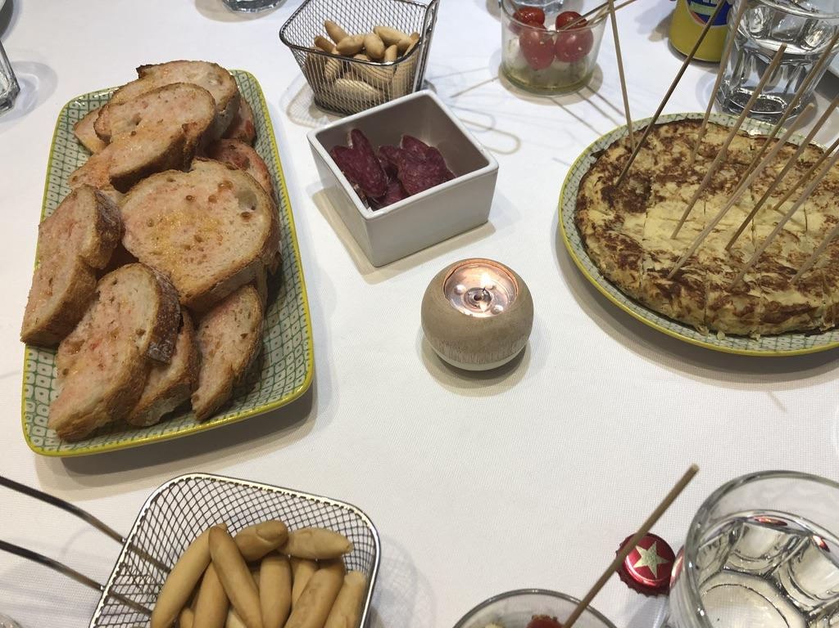
La Comida...
Notes:
Tapas! Very common foods in Barcelona include jamon y queso (ham and cheese) the Spanish Tortillas (omelete made from potatoes, eggs, and onions) and of course the bread eaten the Catalan way! Toasted baguette rubbed with a sliced tomato (to get the juice and seeds on there) and then a rubbed garlic clove for some kick, drizzled with olive oil and then a pinch of salt! Soo good!

Slide 3
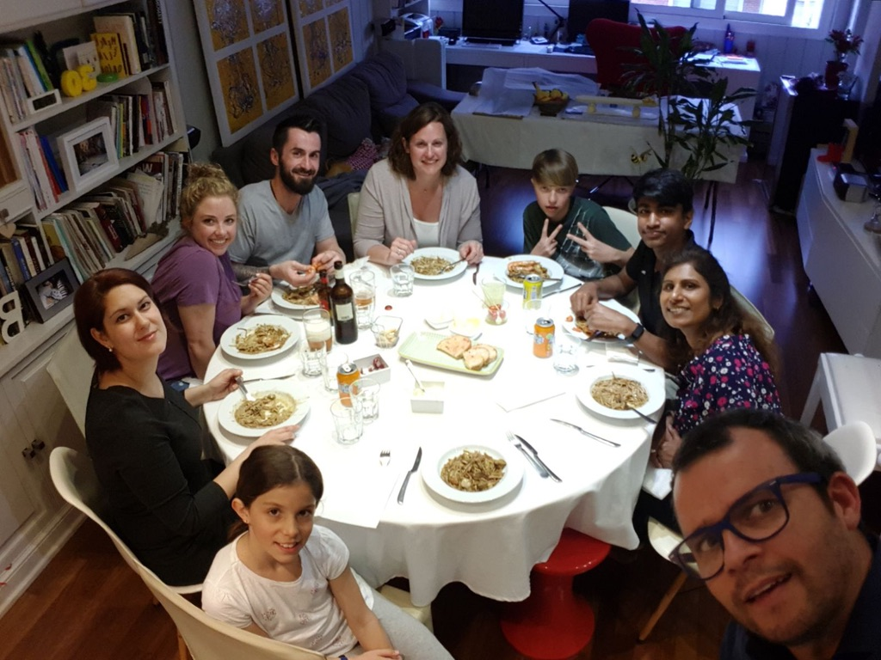
Notes:
A local family hosted us for the evening :) We got to practice our Spanish while enjoying amazing Paella made with noodles instead of rice.

Slide 4
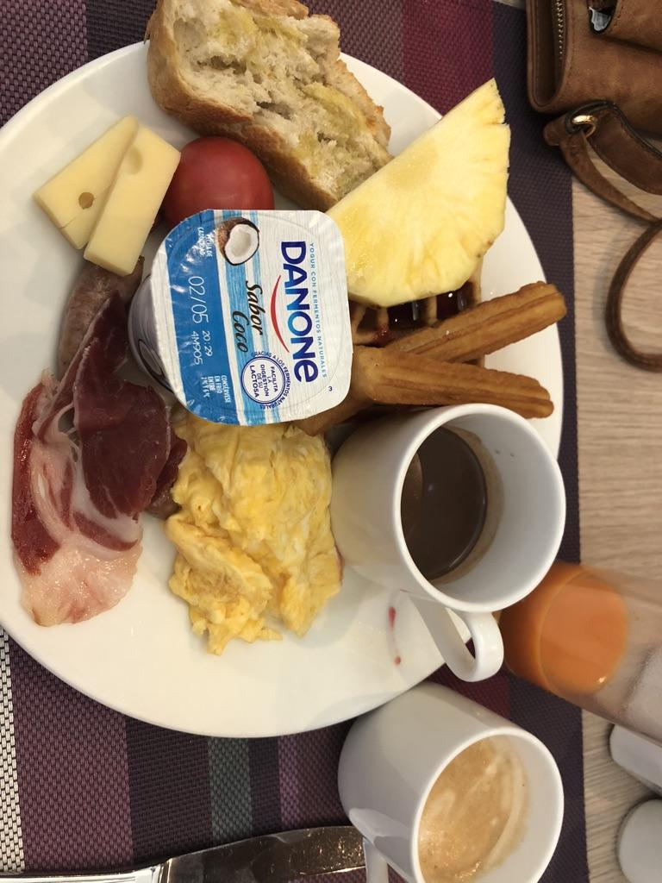
Notes:
Our hotel had amazing breakfast! More catalan bread and the famous churros and chocolate!

Slide 5
Notes:
Students had a cooking class with Julio! He was so passionate about food and so kind and welcoming to us all.

Slide 6
Notes:
More cooking class videos:) We actually made a Spanish Omelet with crunchy potato chips and onion crisps instead of real potatoes and onions--and it was delicious!

Slide 7
Notes:
Yum!! Spaniards love their olive oil!

Slide 8
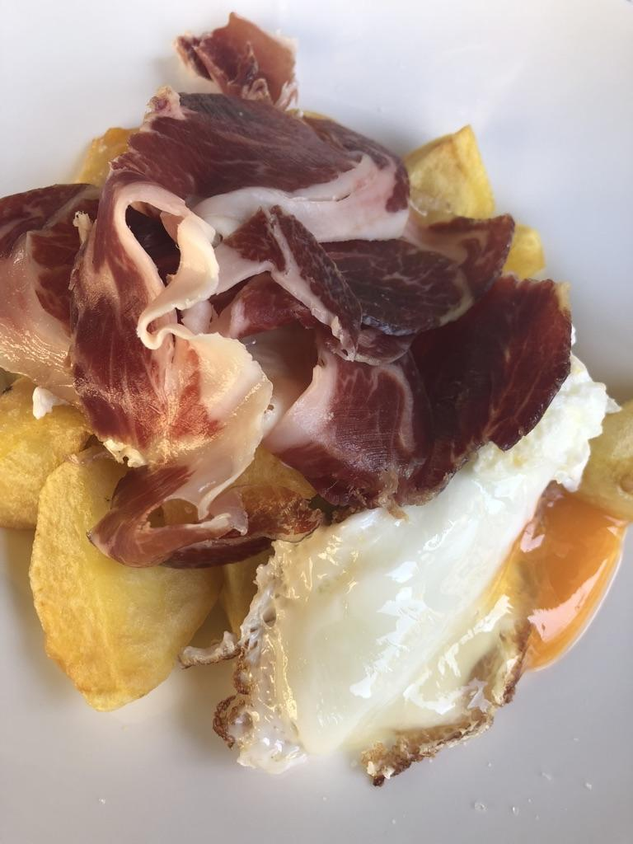
Notes:
A typical tapa ordered from any little cafe or restaurant along the streets of Barcelona. It’s common to serve jamon iberico (cured ham like prosciutto) on top of a fried egg and fries/potato wedges.

Slide 9
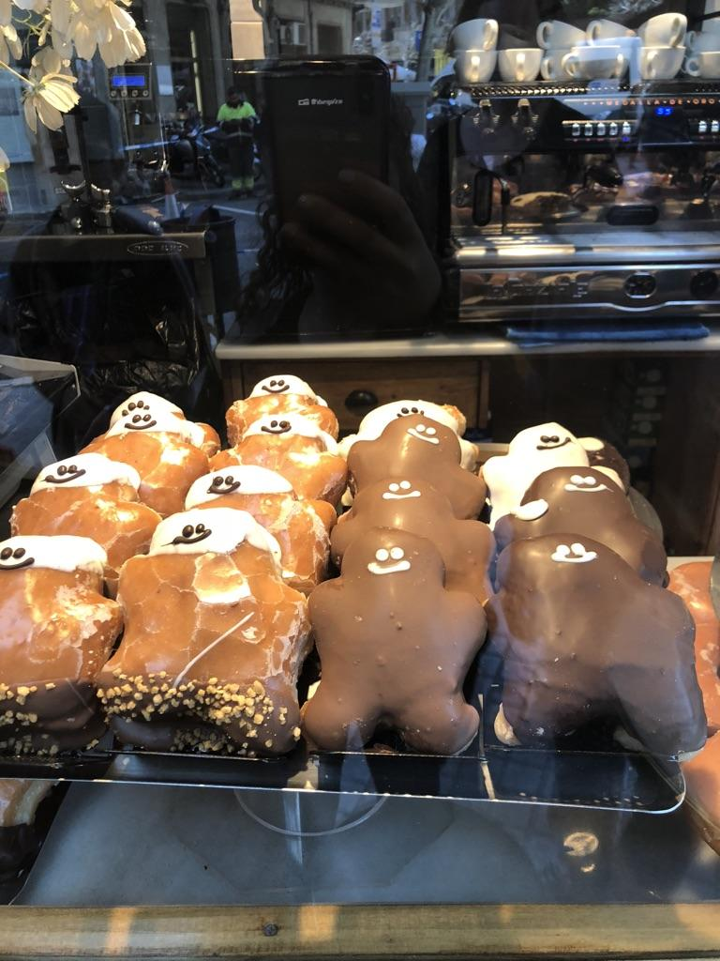
Notes:
So cute!! There are also so many bread shops and bakeries everywhere you walk!

Slide 10
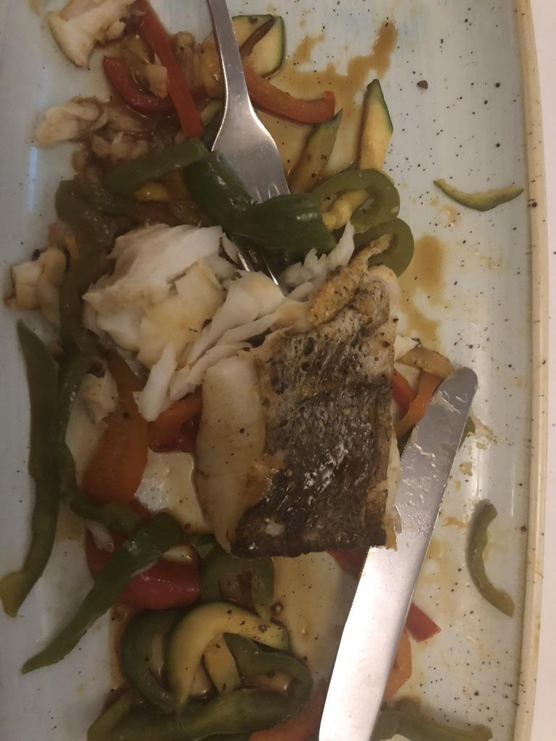
Notes:
We tried something different for dinner each night. This fish was hake and served with a sweet and sour sauce. It was one of the best things we ate! Fresh from the Mediterranean Sea. :)

Slide 11
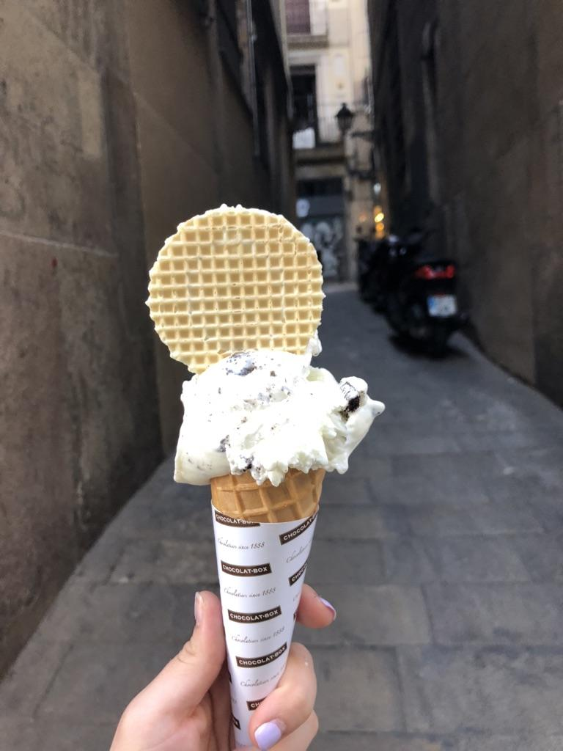
Notes:
Also, gelato shops….everywhere :) for only about 2 euros!

Slide 12
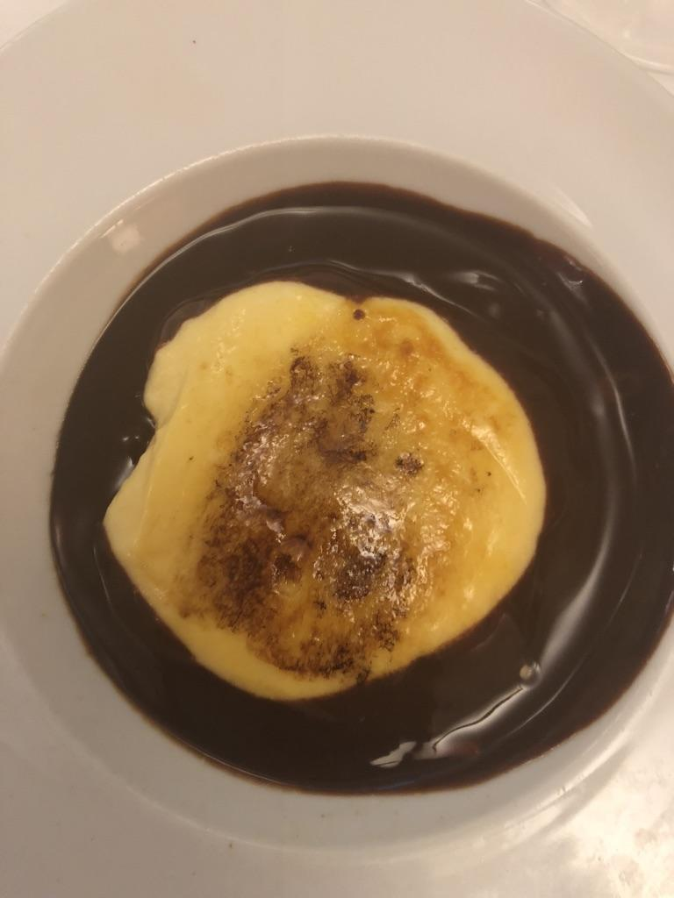
Notes:
Crema Catalana...Very common dessert here, much like creme brulee.

Slide 13
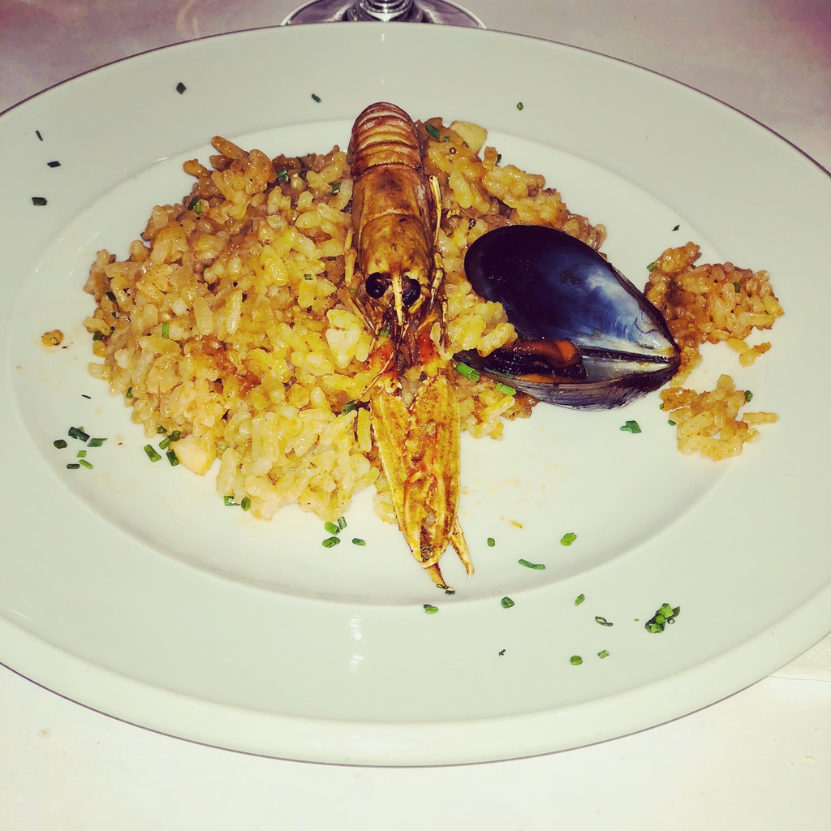
Notes:
Paella :) ….with jumbo shrimp! “Gambas” in Catalan.

Slide 14
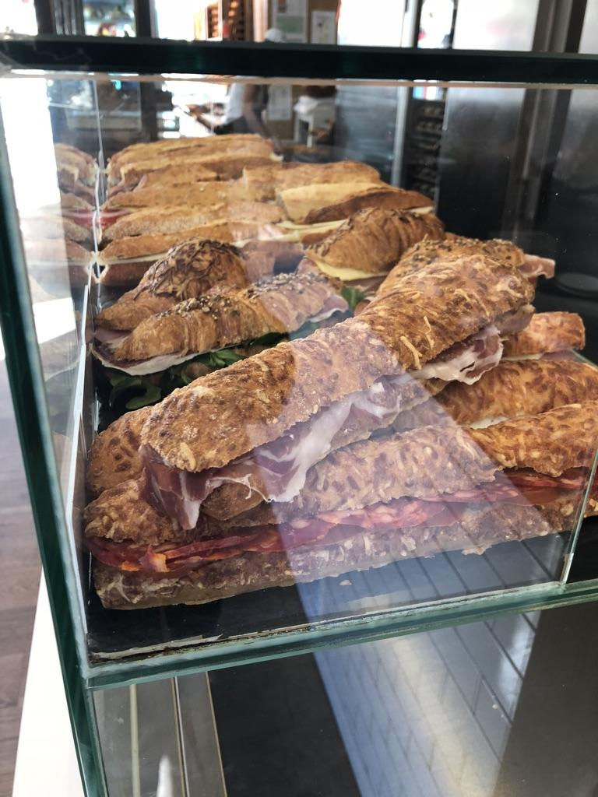
Notes:
Bocadillos (sandwiches) everywhere! So much bread!!

Slide 15
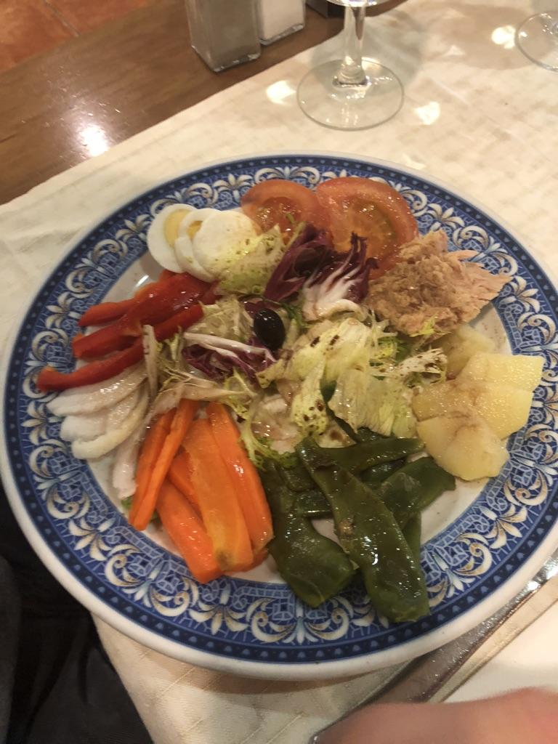
Notes:
Veggies with eggs and tuna

Slide 16
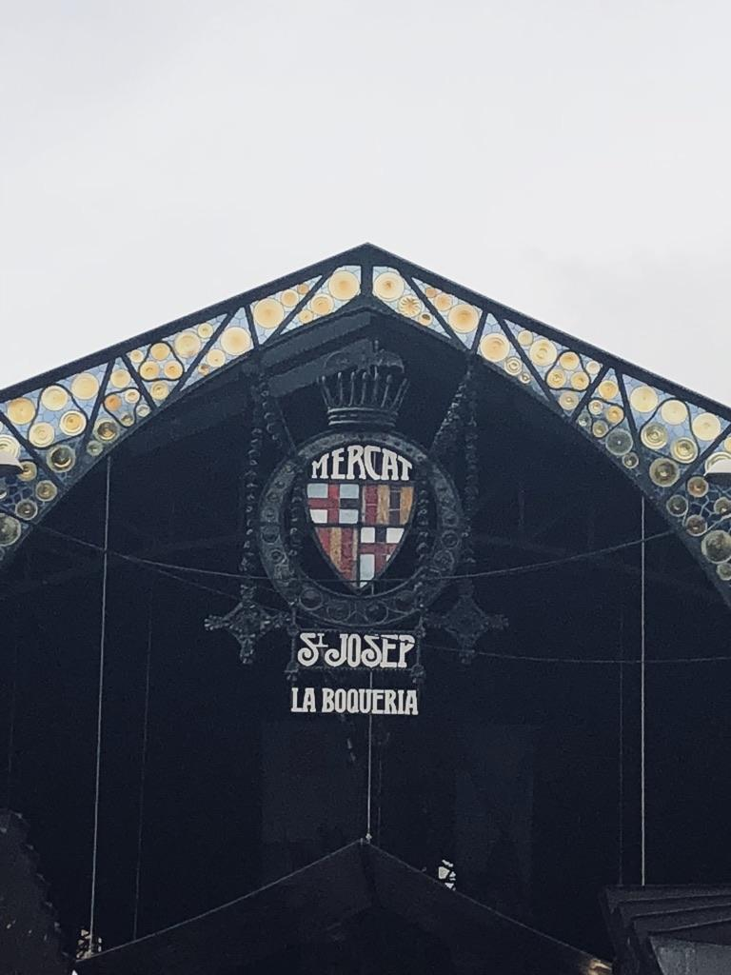
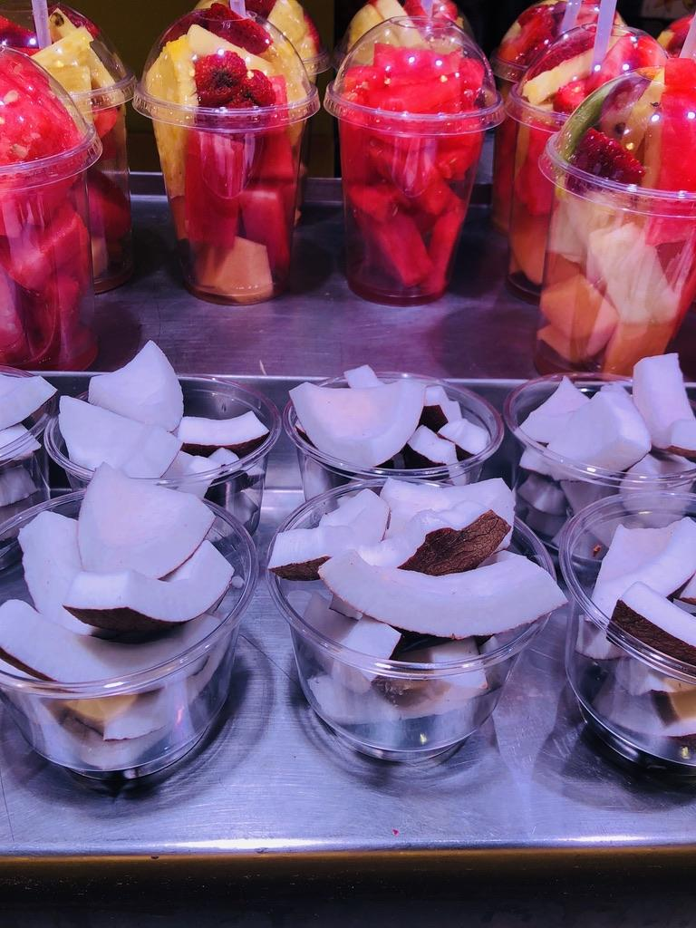
Notes:
The market!!! Inexpensive and Amazing

Slide 17
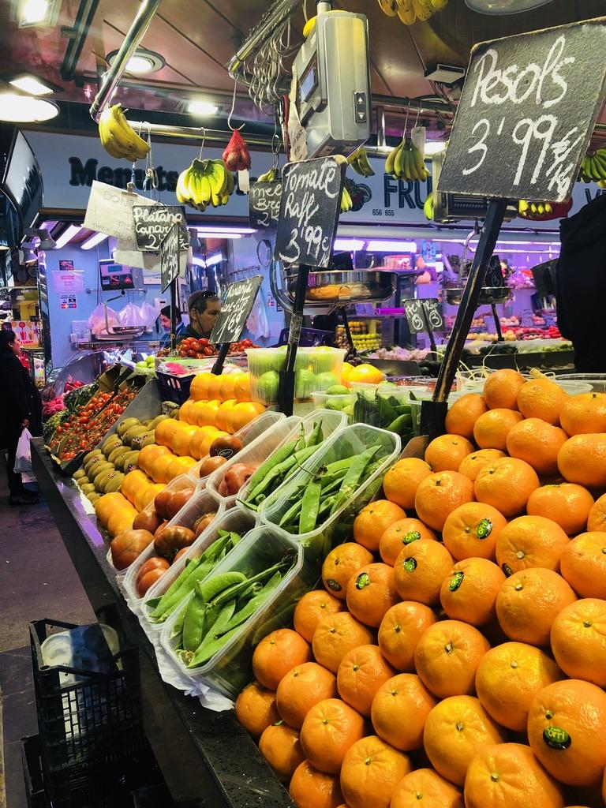
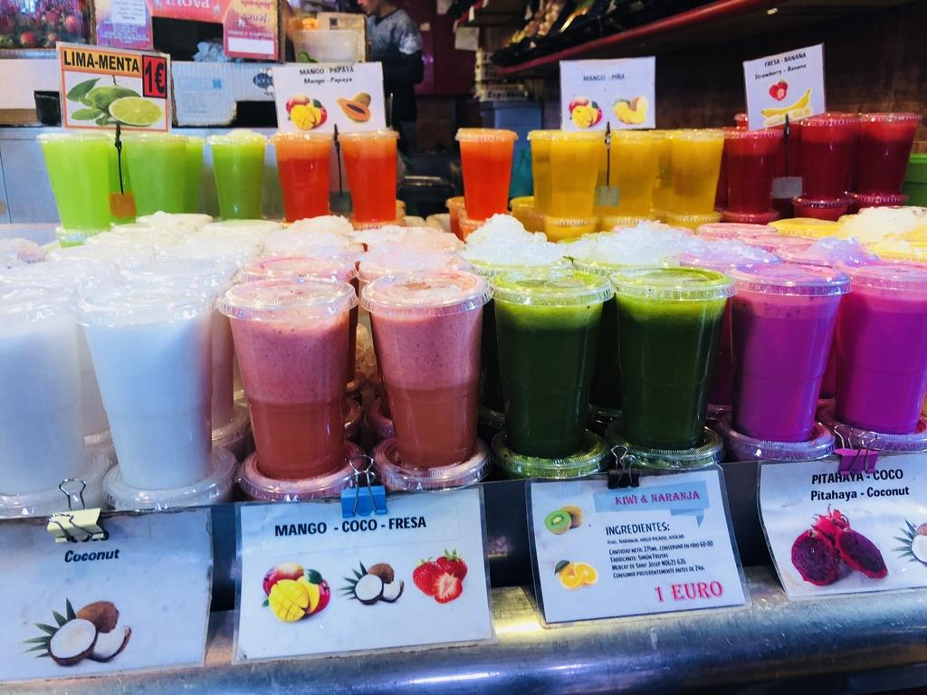
Notes:
Fresh squeezed juices :)..........only for a euro!

Slide 18
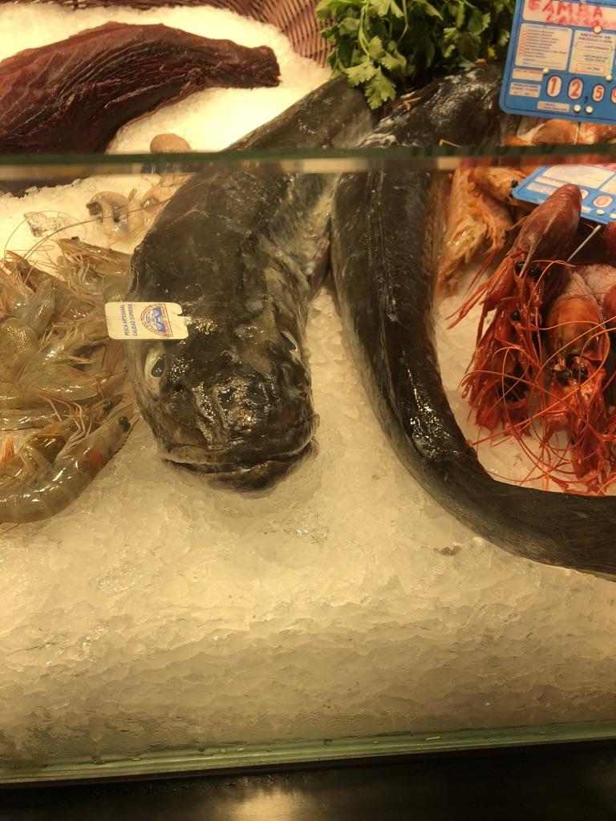
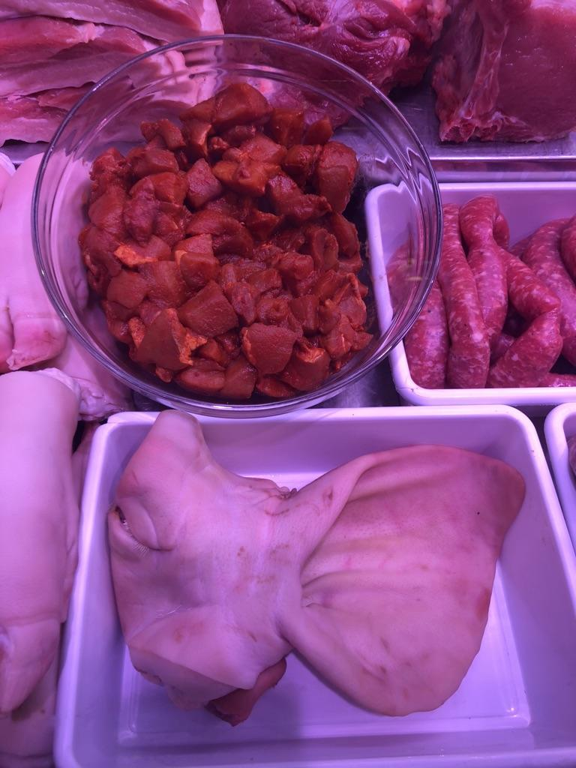
Notes:
Fresh fish and meat…..

Slide 19
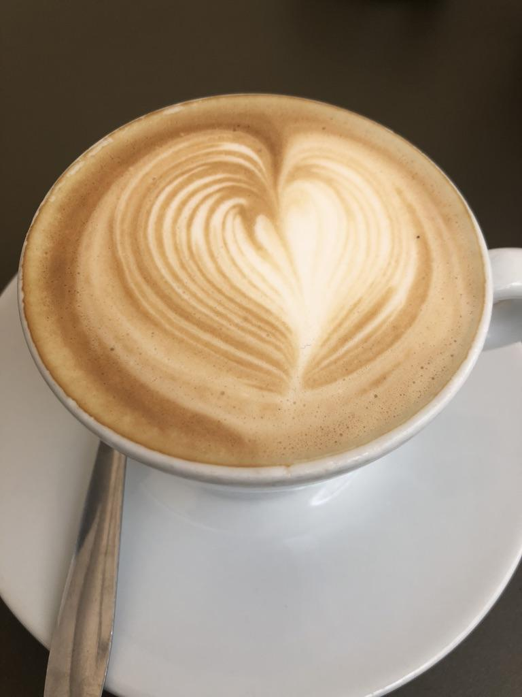
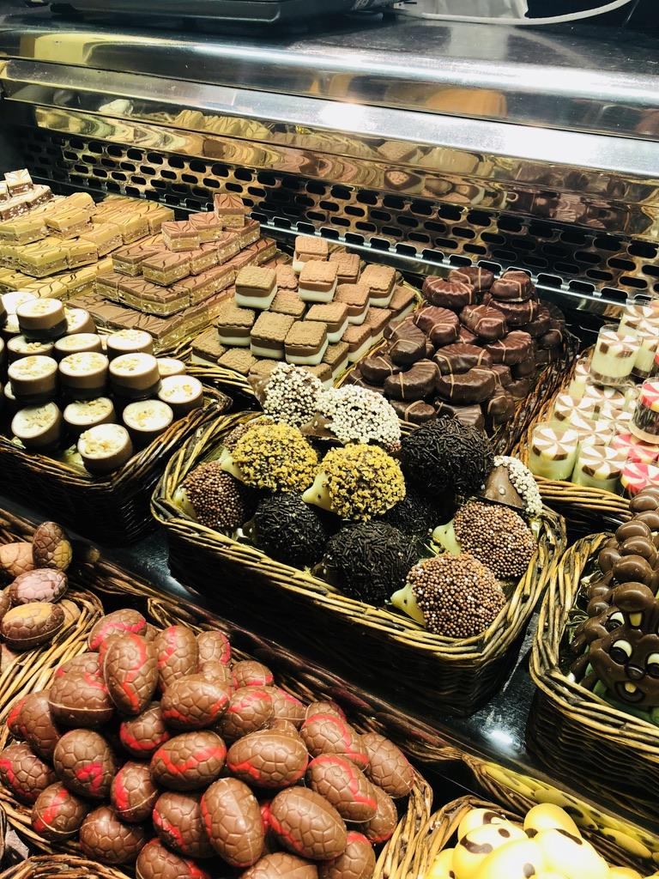
Notes:
The coffee is stronger, therefore always served smaller. So good!

Slide 20
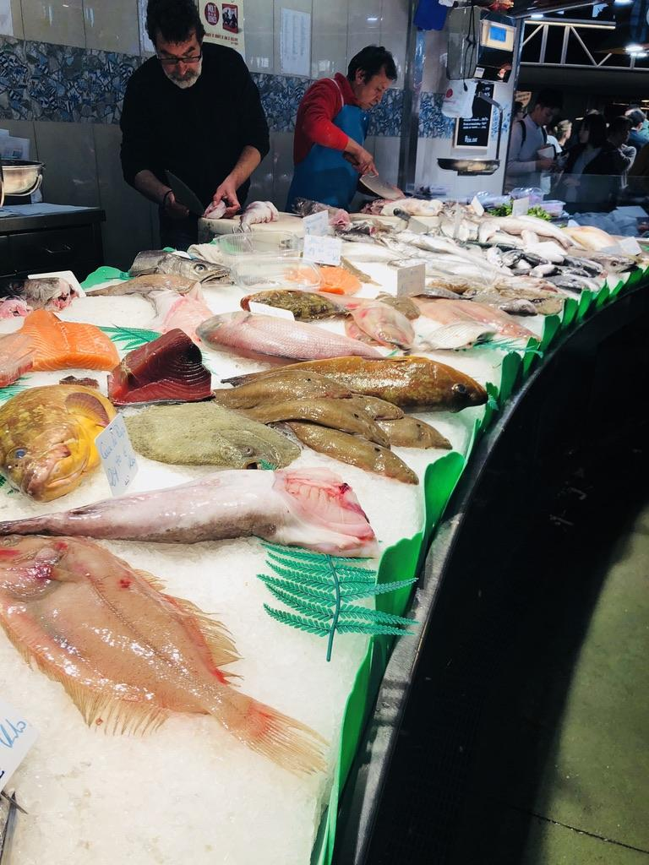
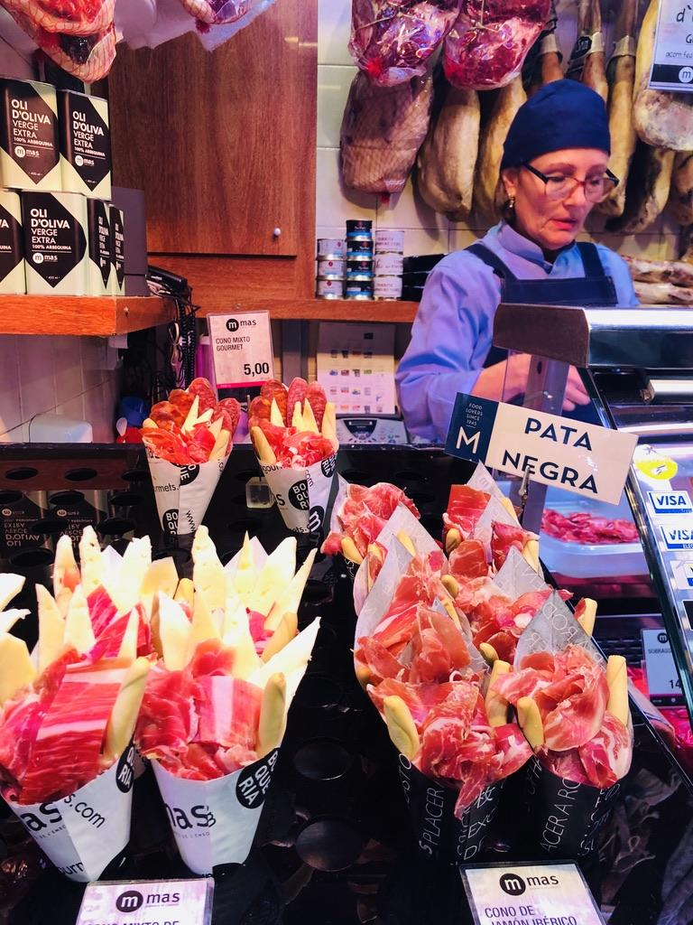
Notes:
Some workers:) Very friendly...students had to ask them questions during a scavenger hunt

Slide 21
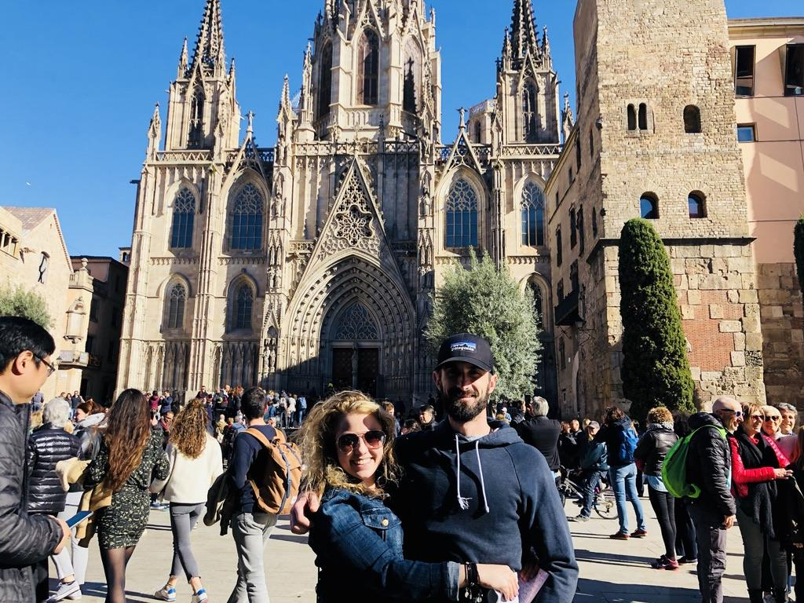
El Arte...
Notes:
The catedral de Barcelona :)

Slide 22
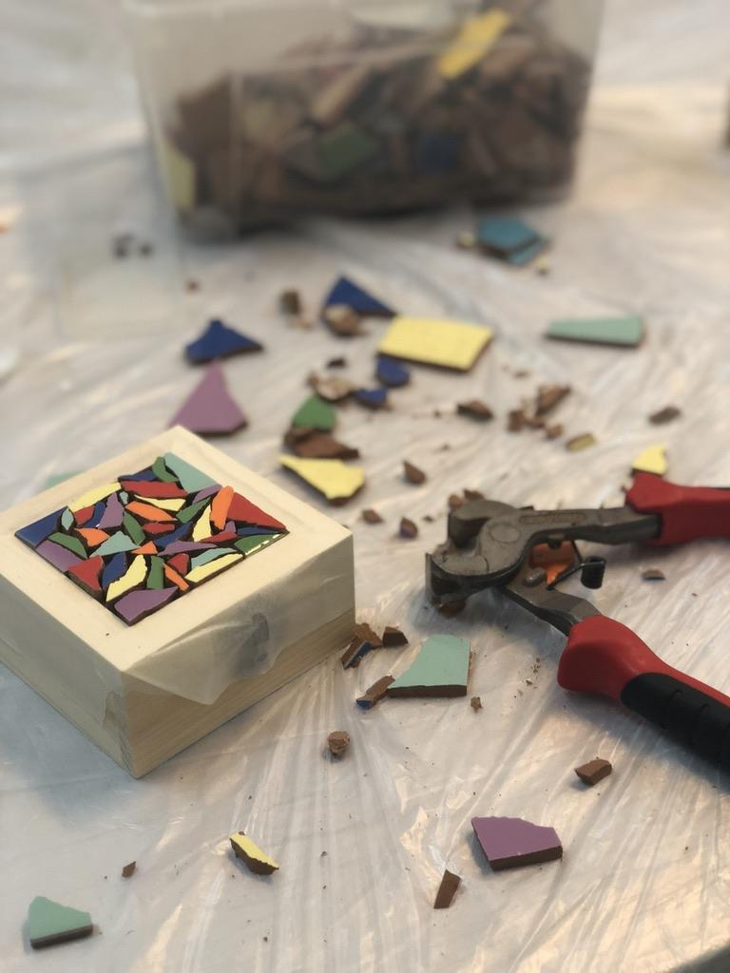
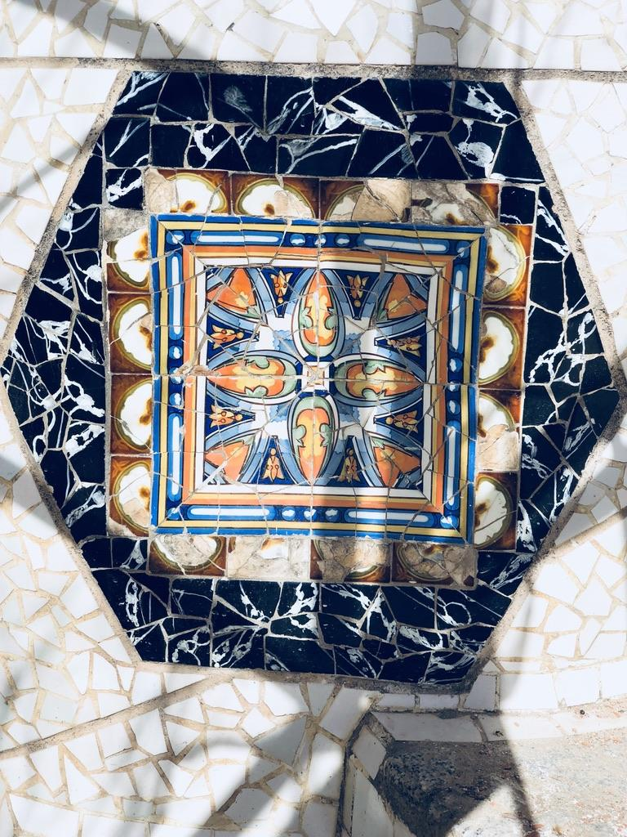
Notes:
We took part in an art workshop making mosaic designs to reflect Antoni Gaudi's architecture. It was a lot of fun!

Slide 23
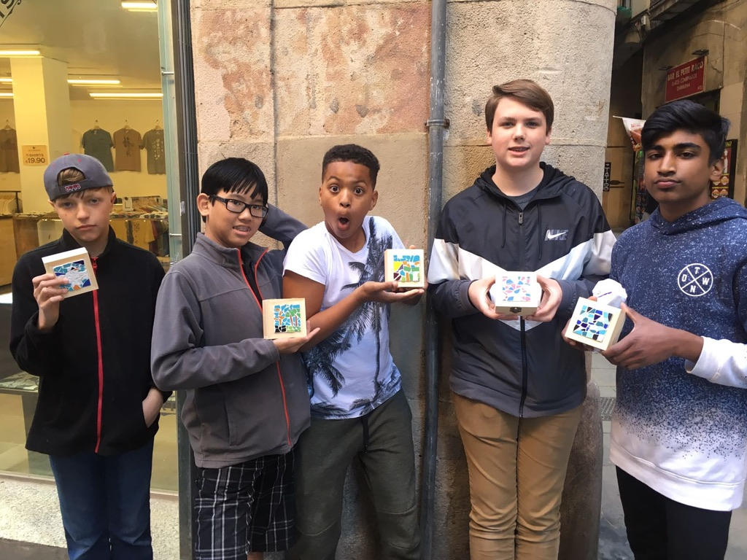
Notes:
The boys with their artwork! Great souvenirs! :)

Slide 24
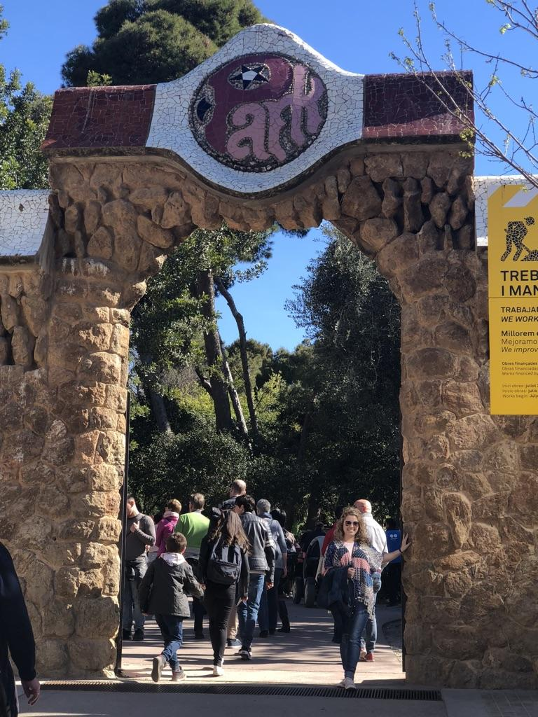
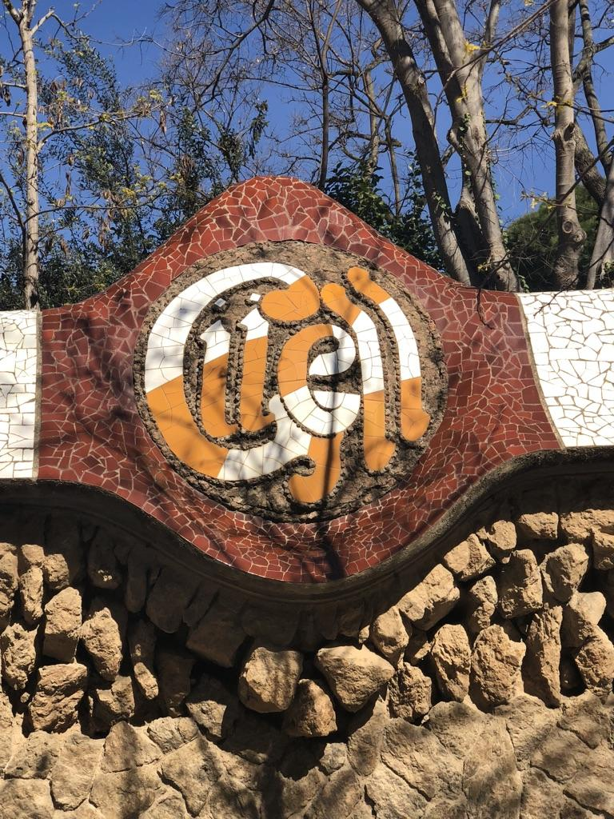
Notes:
Time to explore the magical and mystical Park Guell!

Slide 25
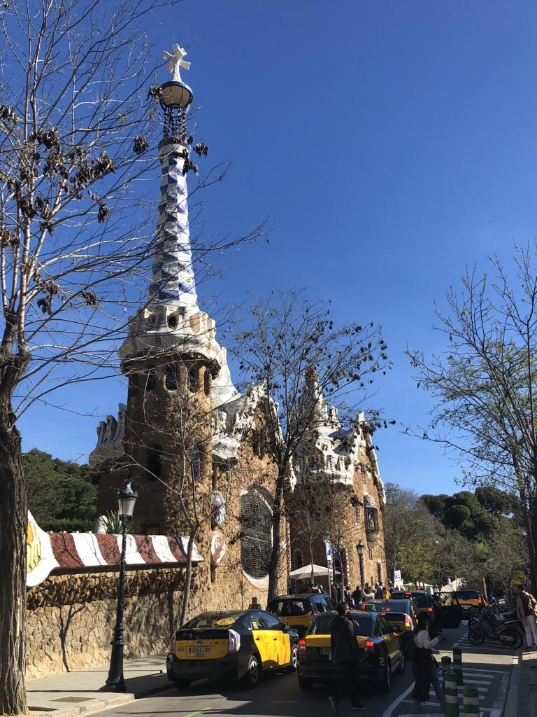
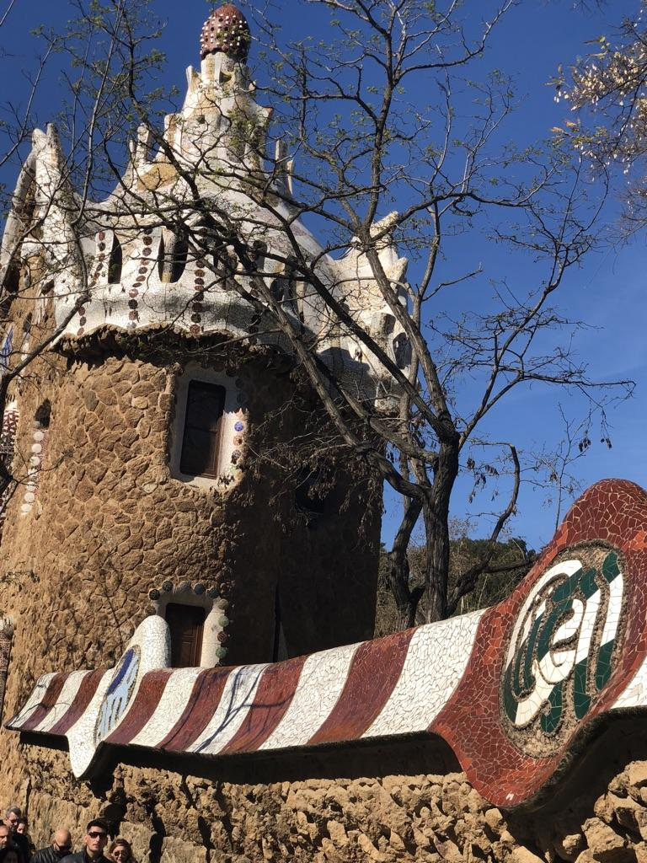
Notes:
Gaudi designed these houses at the entrance to represent gingerbread houses (inspired from Hansel and Gretel.)

Slide 26
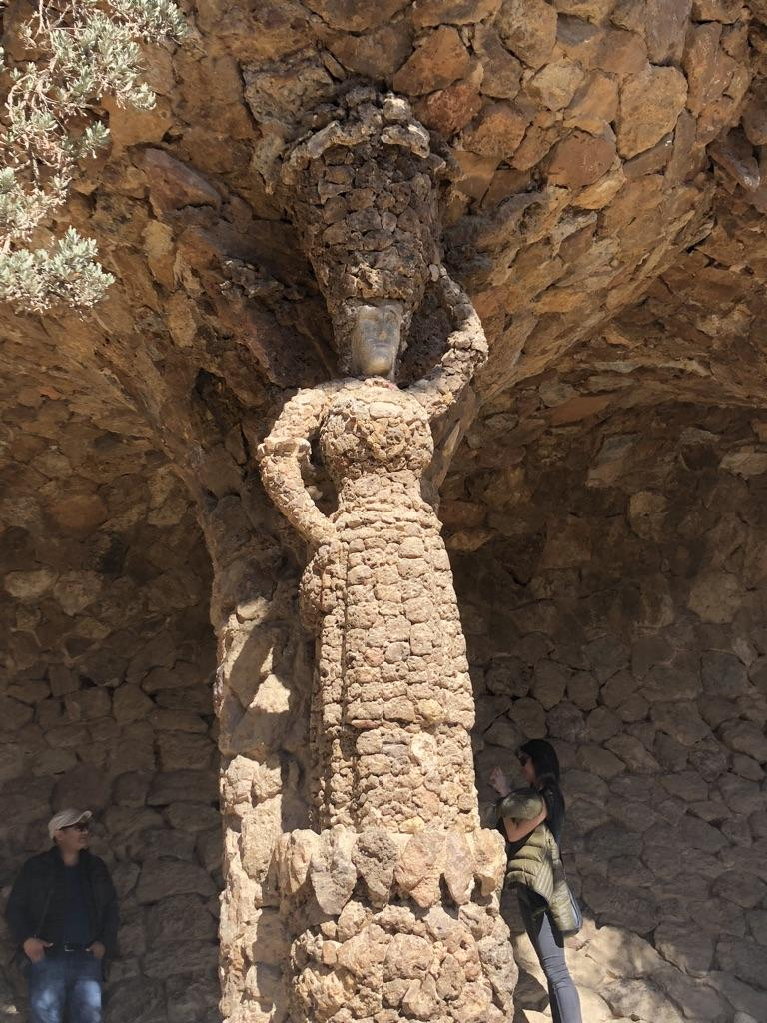
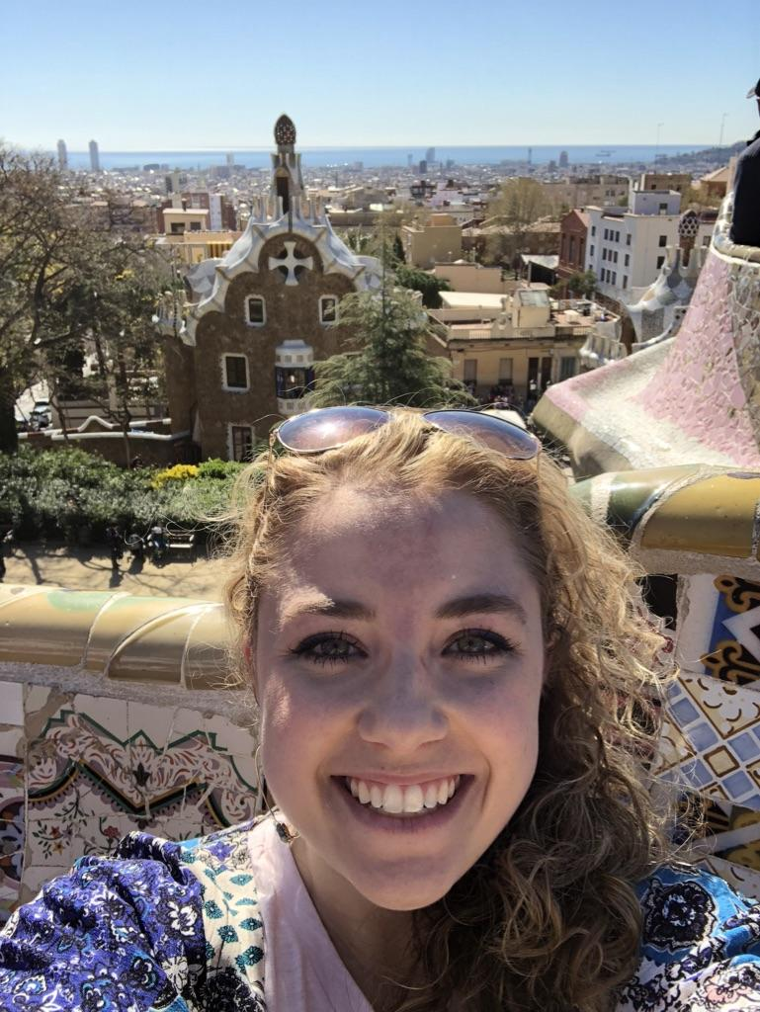
Notes:
Everywhere you would walk, there was always a surprise! The mosaics were so beautiful!

Slide 27
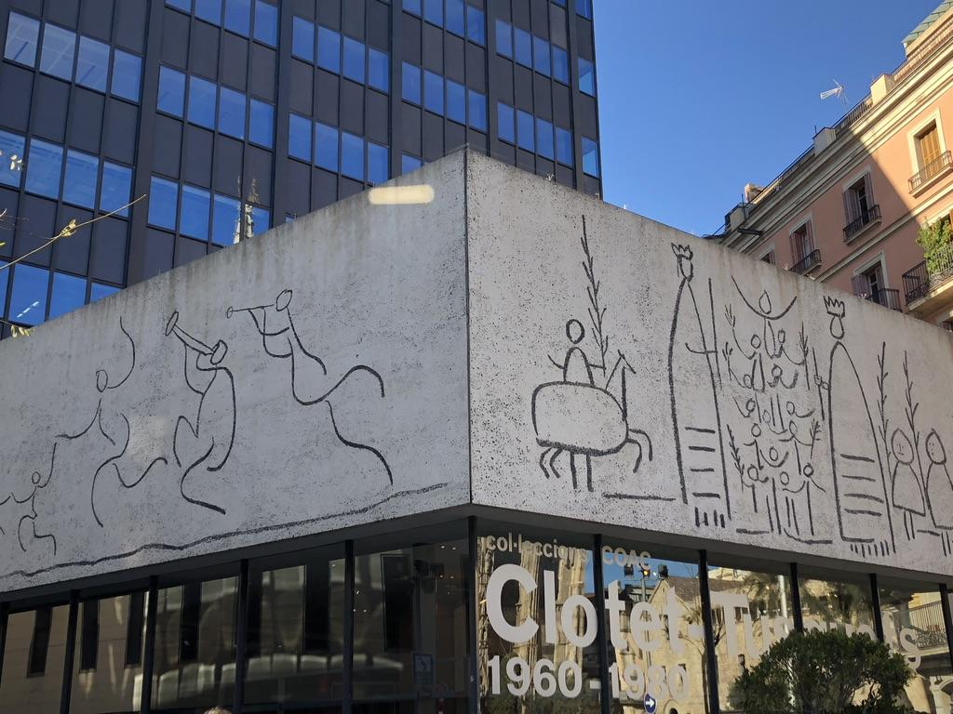
Notes:
The work of Pablo Picasso on the architecture building. It’s said the older he got, the more he painted like a child.

Slide 28
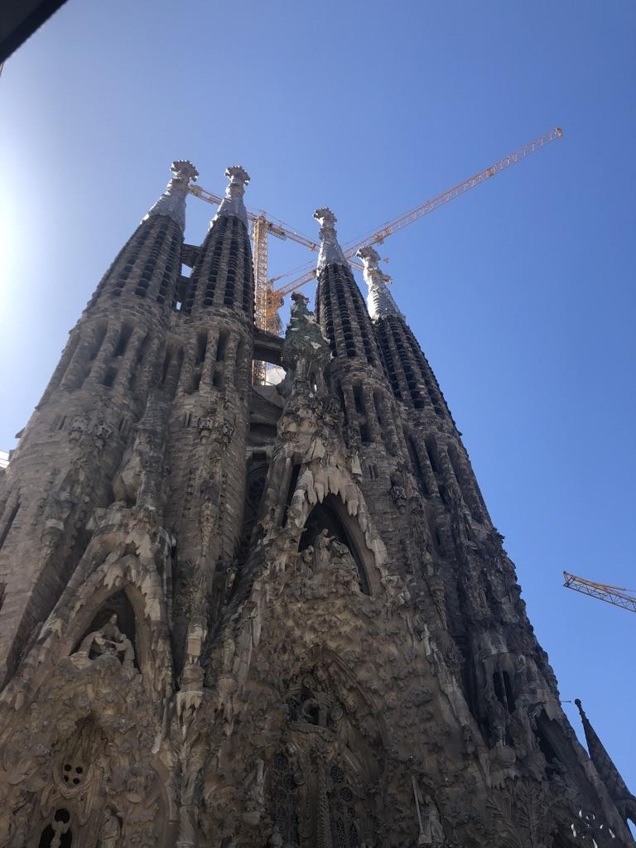
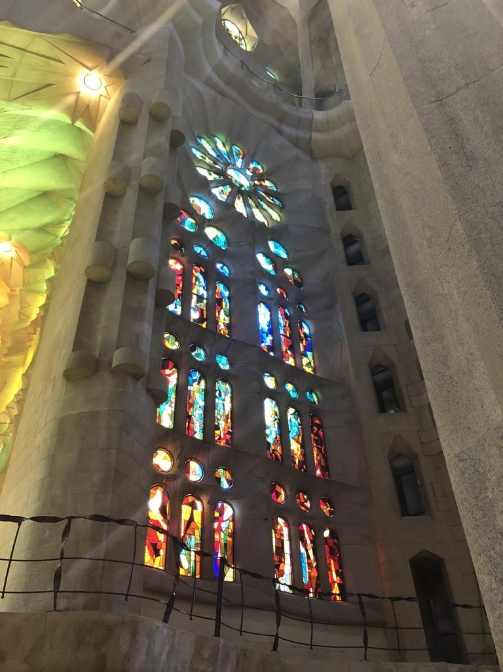
Notes:
The beauty of La Sagrada Familia! It was breathtaking.

Slide 29
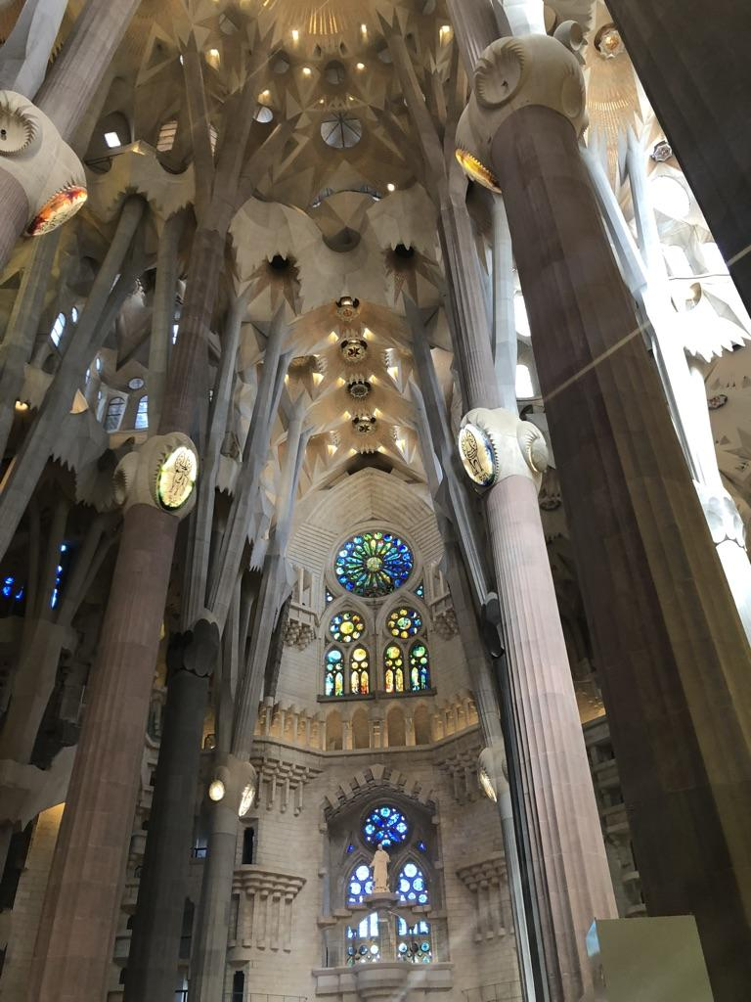
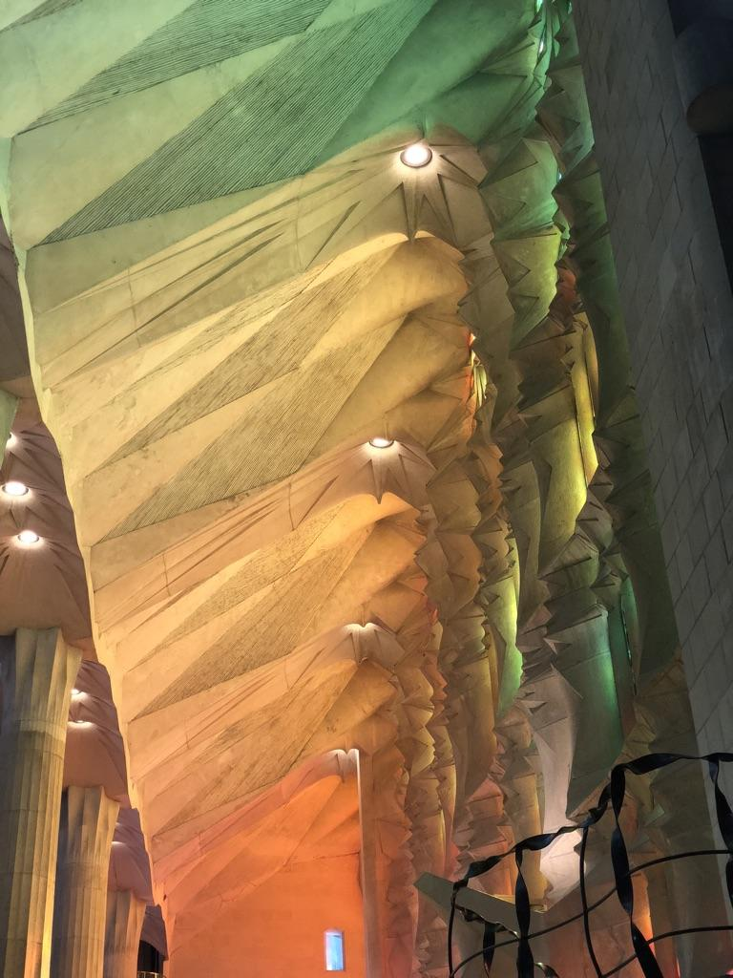
Notes:
Made to look like an enchanted forest inside...

Slide 30
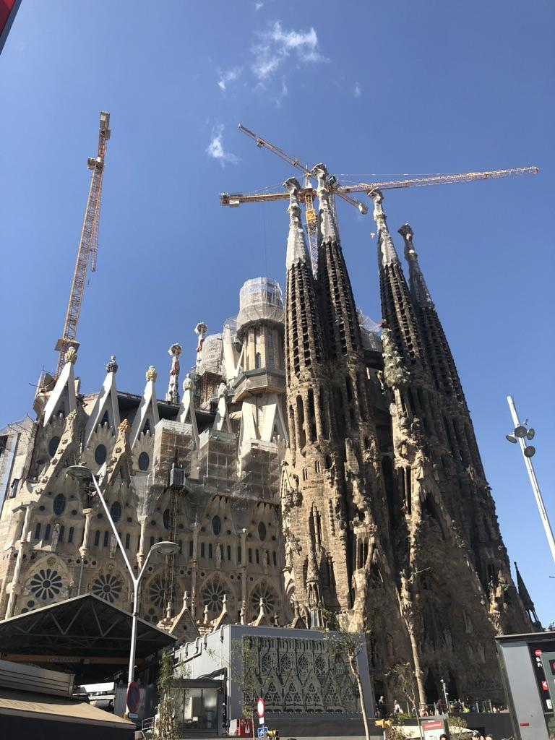
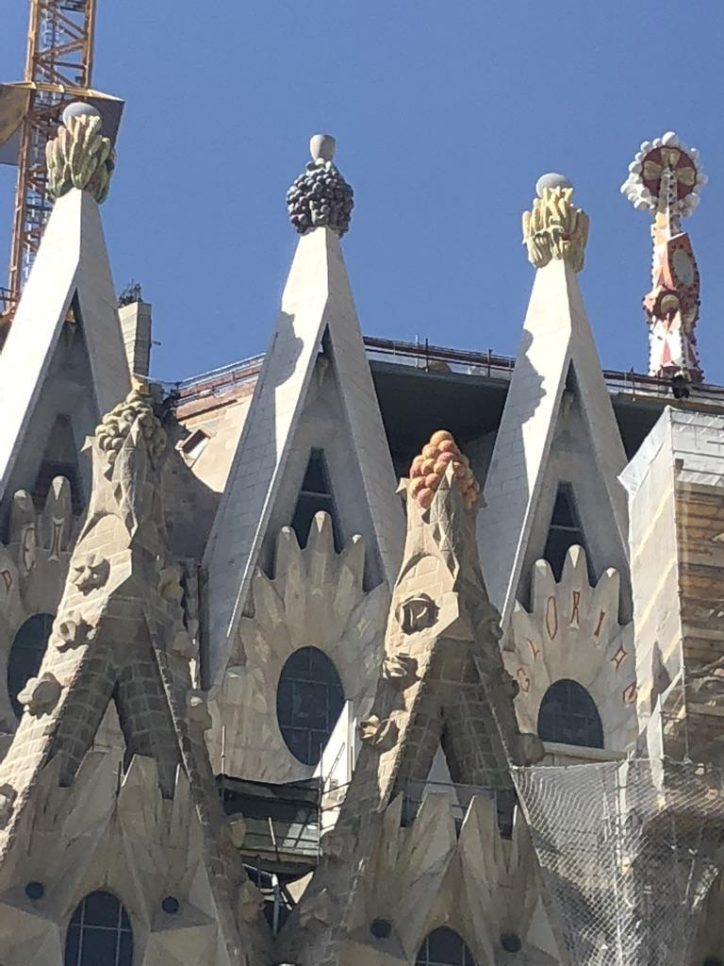
Notes:
More of the outside...the church won’t be completed for another 10 years.

Slide 31
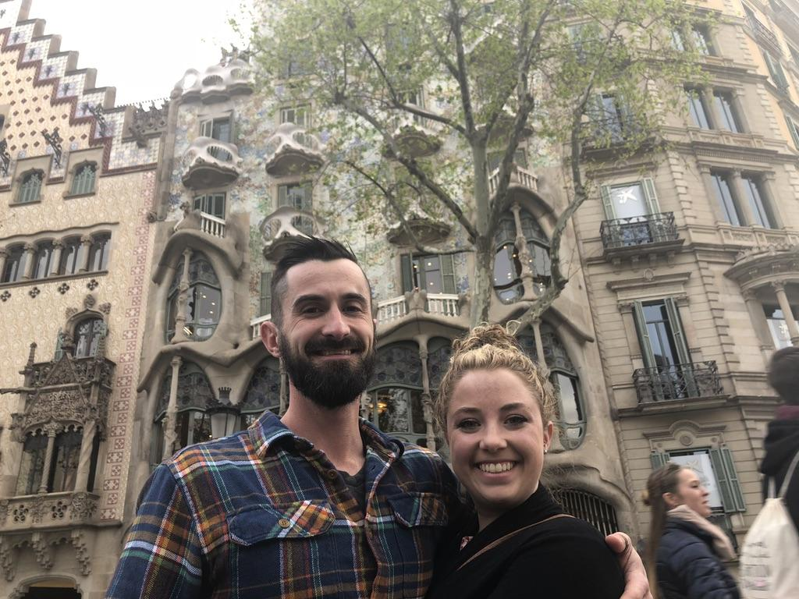
Notes:
Another Gaudi masterpiece...Casa Batllo.

Slide 32
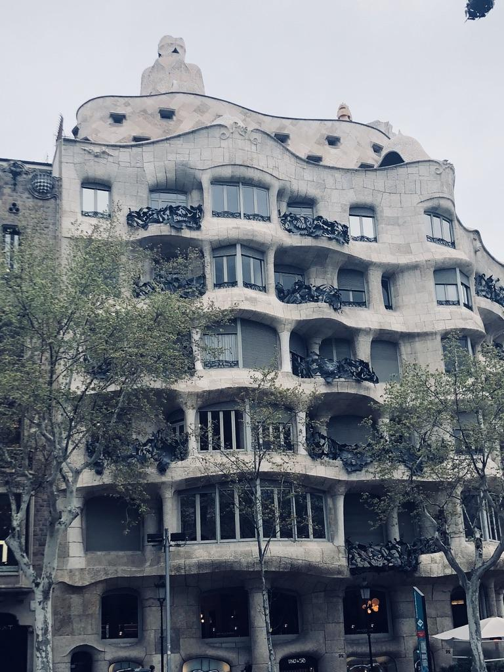
Notes:
And another...Casa Mila! or La Pedrera. Made out of stone to resemble a rock quarry.

Slide 33
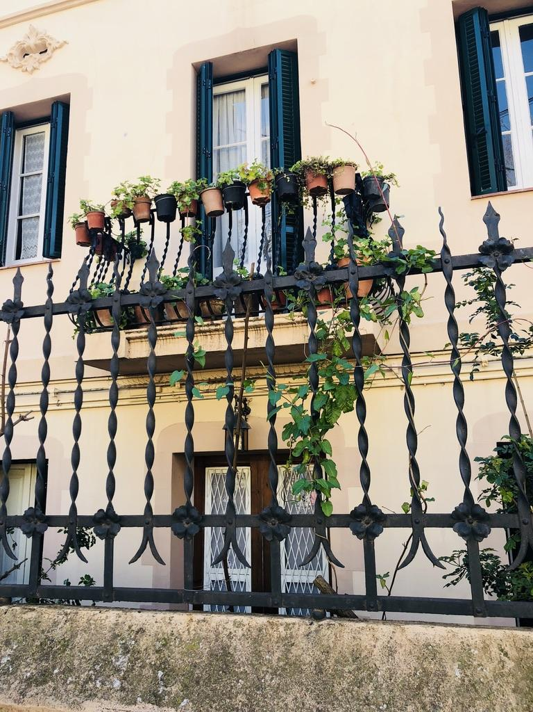
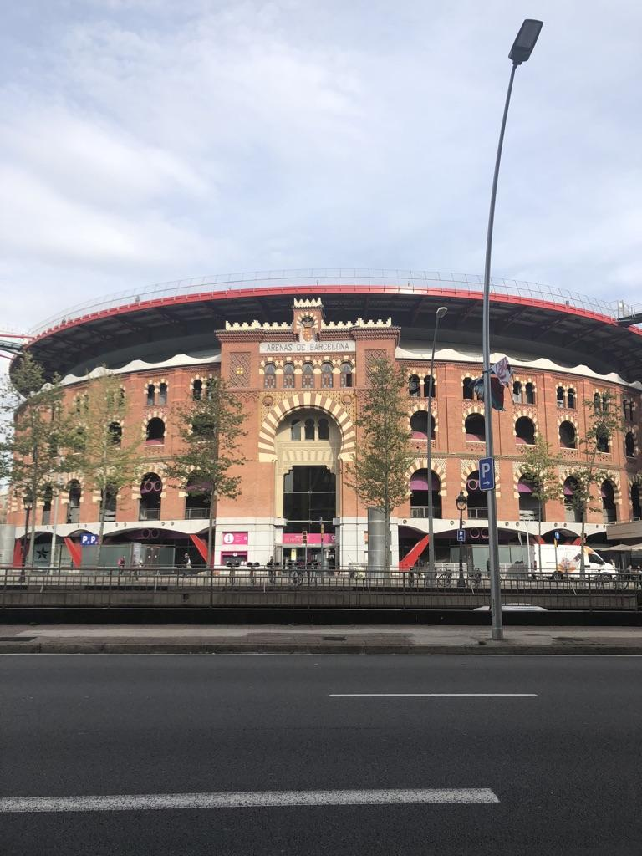
Notes:
Beautiful balconies and a once bull fighting ring turned mall!

Slide 34
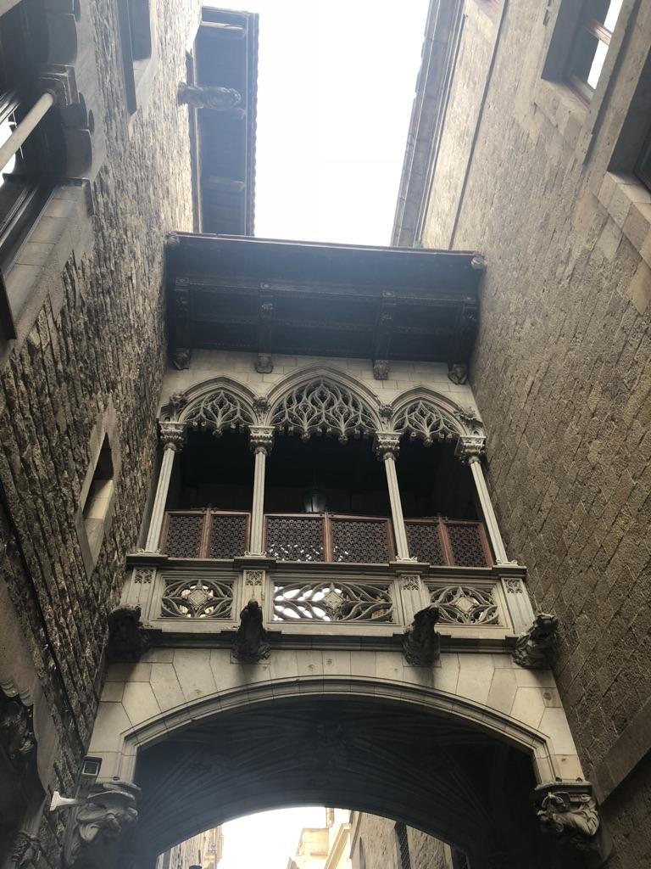
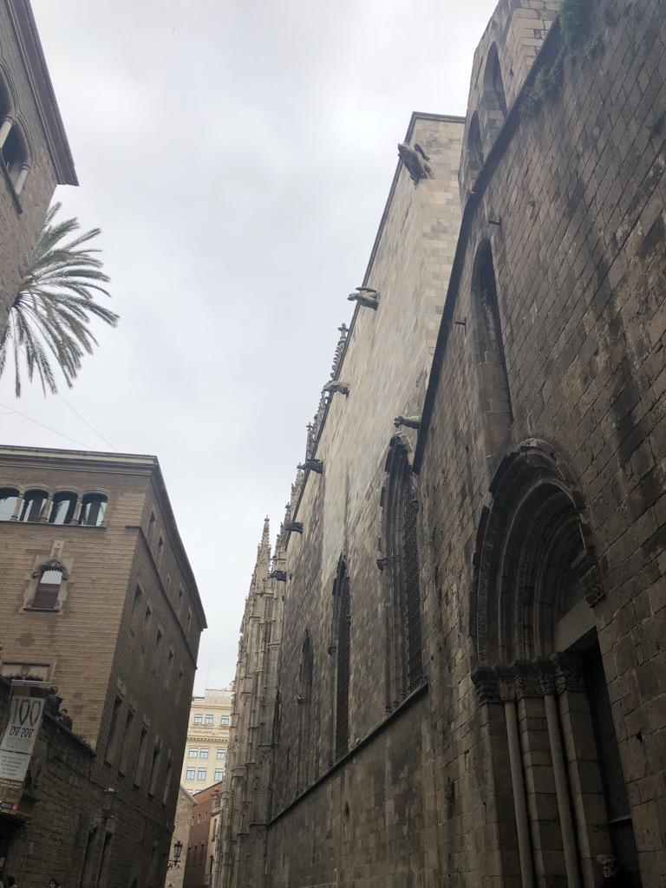
Notes:
The Gothic Quarters….Barcelona was so neat because it was intermixed with old and new buildings so close together!

Slide 35
Notes:
Must walk backwards and stare up at the skull if you want to return to Barcelona!

Slide 36
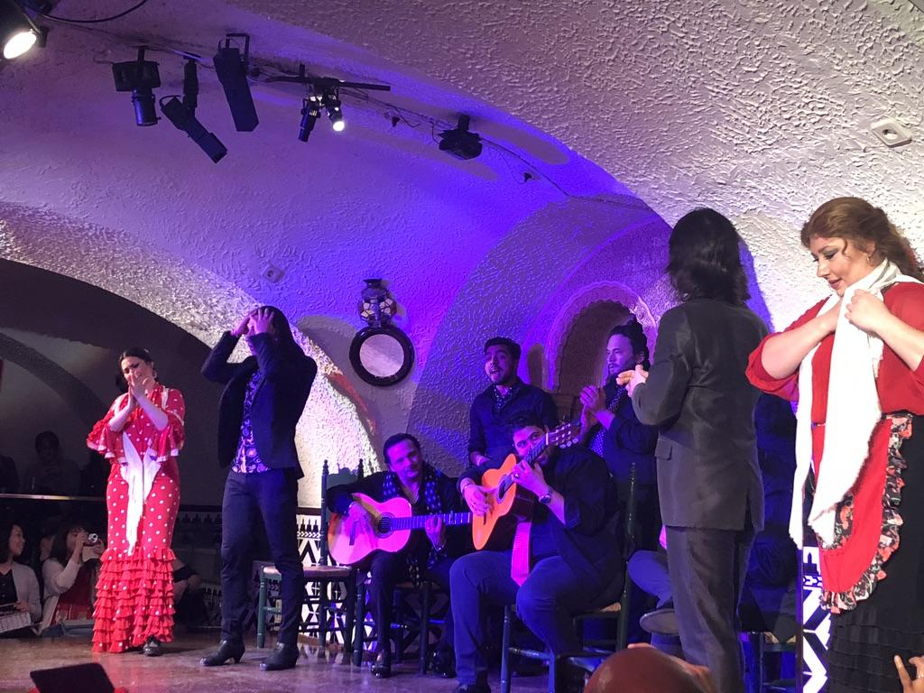
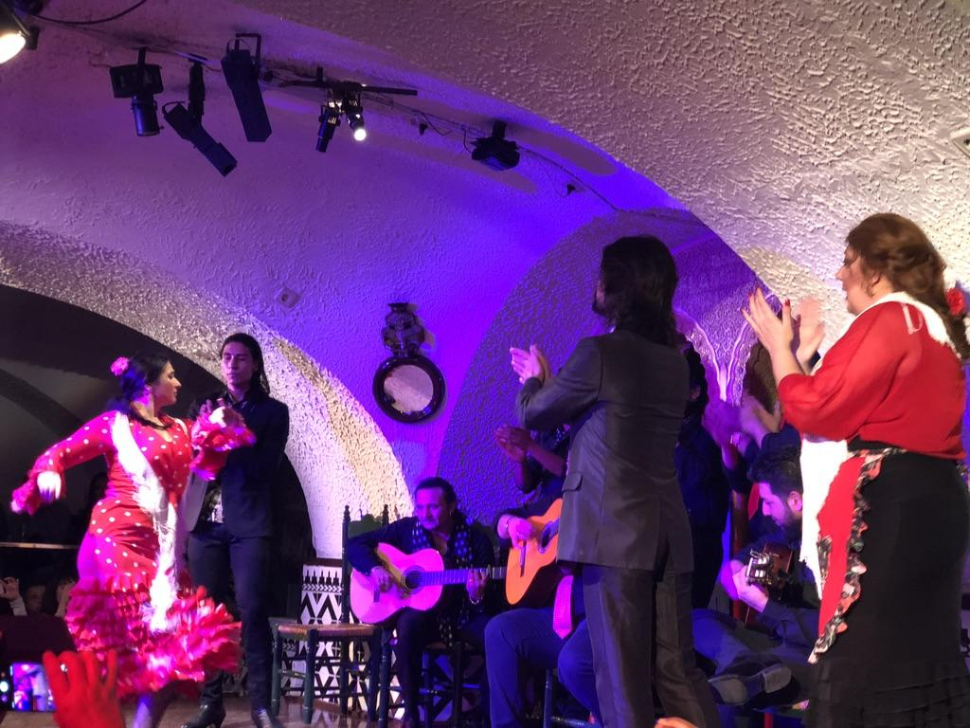
El Flamenco...
Notes:
The passionate dance of Spain

Slide 37
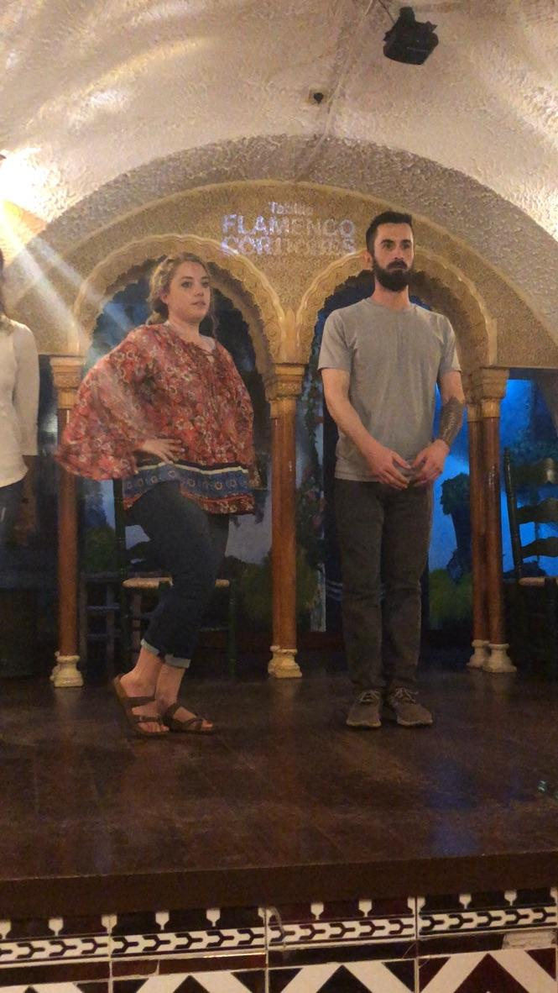
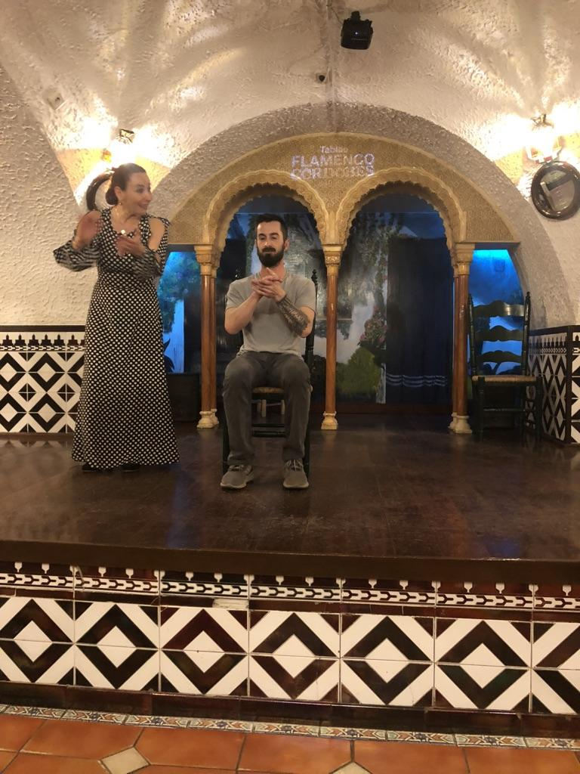
Notes:
Taking lessons! Students had a lot of fun with this interactive class as well!

Slide 38
Notes:
More Flamenco Class…. On the right is a local girl teaching us how to dance La Sardana (another famous Catalan Dance.)

Slide 39
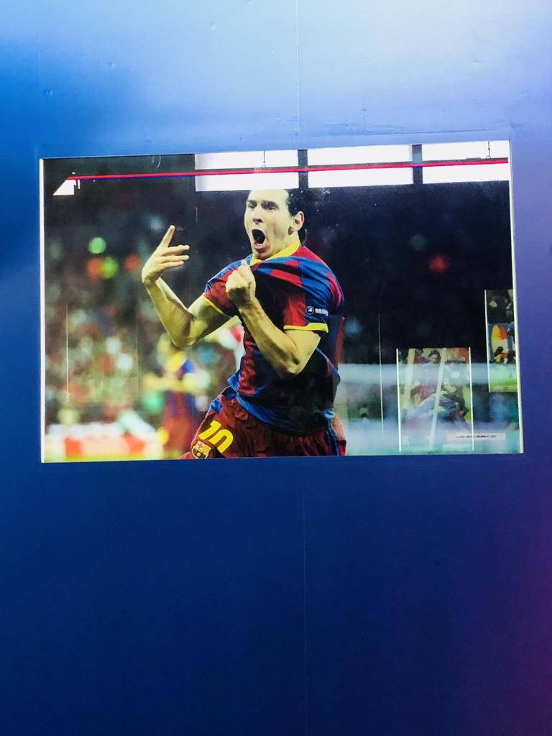
El fútbol...
Notes:
And of course soccer!!

Slide 40
Notes:
“More than a club…”

Slide 41
Notes:
Loved seeing all of Messi’s things!

Slide 42
Notes:
The group loved the stadium tour!

Slide 43
La Cultura...
Notes:
Students became self-confident from this experience, and they learned how to read maps and navigate the metro by themselves!

Slide 44
Notes:
Videos from the school we visited on the outskirts of Barcelona. The kids loved having us!!

Slide 45
Notes:
Hulahoopin :)

Slide 46
Notes:
Graduation Time!

Slide 47
Notes:
Students took language classes each morning and received credit at the end of the week.

Slide 48
Notes:
The port and the Columbus monument

Slide 49
Notes:
Travis and the boys became obsessed with Spain’s hot chocolate. :)

Slide 50
Notes:
The coast!

Slide 51
Notes:
Patricia was our amazing tour guide who was with us 24/7. She truly made the trip and our first EF tour experience all worth it!!

